Slide 1



Waste Classification Using CNN Model

Slide 2

1. Learning Objectives
Understand Machine Learning and its applications in image classification.
Explore Deep Learning concepts with Convolutional Neural Networks (CNNs).
Learn about Exploratory Data Analysis (EDA) for understanding dataset characteristics.
Implement Model Deployment to make the trained model usable in real-world applications.
Utilize Google Colab and VS Code as development environments.
GOAL
Github: Click Here

Slide 3
2.Tools and Technology used
2.1 Machine Learning & Deep Learning Frameworks:
TensorFlow
Keras
OpenCV
Scikit-learn
2.2 Development Environments:
Google Colab
      VS Code
      Github
2.3 Other Libraries Used in Source Code:
Matplotlib (for data visualization)
NumPy & Pandas (for data handling)
TensorFlow/Keras (for building CNN model)

Slide 4
3. Methodology
3.1 Data Collection & Preprocessing:
Gathered waste images and categorized them into recyclable and non-recyclable.
Performed image augmentation techniques to improve model generalization.
3.2 Exploratory Data Analysis (EDA):
Visualized image distributions, size variations, and class imbalances.
3.3 Model Building (CNN Architecture):
Designed a CNN model with convolutional, pooling, and fully connected layers.
Applied activation functions like ReLU and Sigmoid.

Slide 5
3.4 Training & Evaluation:
Split the dataset into training and testing sets.
Used loss functions and optimization techniques like Adam optimizer.
3.5 Model Deployment:
Exported the trained model for real-time waste classification applications.

Slide 6
4. Problem Statement:
Managing waste efficiently is a global challenge. Misclassification of waste leads to improper recycling, increased pollution, and inefficient waste management. There is a need for an automated system that accurately classifies waste into different categories to support proper disposal and recycling efforts.
Inefficient Manual Sorting: Traditional waste classification methods rely on human effort, which is prone to errors, slow, and costly.
Environmental Impact: Incorrect disposal of recyclable and non-recyclable waste leads to pollution, affecting ecosystems and contributing to climate change.

Slide 7
5. Solution:
To address the challenges of inefficient waste classification, we have developed a Waste Classification Model using Deep Learning (CNN). This model is designed to recognize and classify waste into two primary categories:
1. Organic Waste :
Organic waste consists of biodegradable materials that decompose naturally over time. Proper disposal of organic waste is essential for composting and reducing landfill accumulation. The model recognizes various types of organic waste, including:
Food Scraps: Leftover fruits, vegetables, grains, and cooked food waste.
Garden Waste: Leaves, grass clippings, branches, and plant-based materials.
Paper-Based Waste: Used napkins, cardboard (if contaminated with food), and biodegradable packaging.

Slide 8
2. Recyclable Waste:
Recyclable waste consists of materials that do not decompose easily but can be reprocessed and reused. The model identifies different types of recyclable waste, such as:
Plastics: Bottles, containers, and packaging materials made of PET, HDPE, and other recyclable polymers.
Metals: Aluminum cans, tin containers, and scrap metals that can be melted down and repurposed.
Paper & Cardboard: Newspapers, magazines, office paper, and clean cardboard packaging.
Glass: Bottles, jars, and glass containers that can be cleaned and reused.
E-Waste (Limited Scope): Small electronic components such as old mobile phones, batteries, and circuits (if applicable in future enhancements).

Slide 9
6. Core Advantages of the Solution:
Automated Waste Recognition:
Uses a Convolutional Neural Network (CNN) to analyze waste images and classify them accurately.
2. Improved Sorting Efficiency:
Reduces manual effort and increases speed in waste management processes.
3. Enhanced Accuracy:
Trained on a diverse dataset to improve classification performance.
4. Environmental Impact:
Encourages proper waste segregation, leading to efficient recycling and reduced landfill waste.

Slide 10

7. Screenshot of Output:

Slide 11
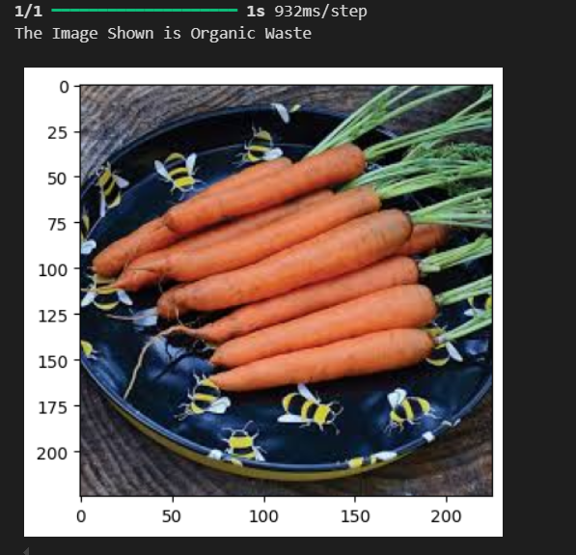
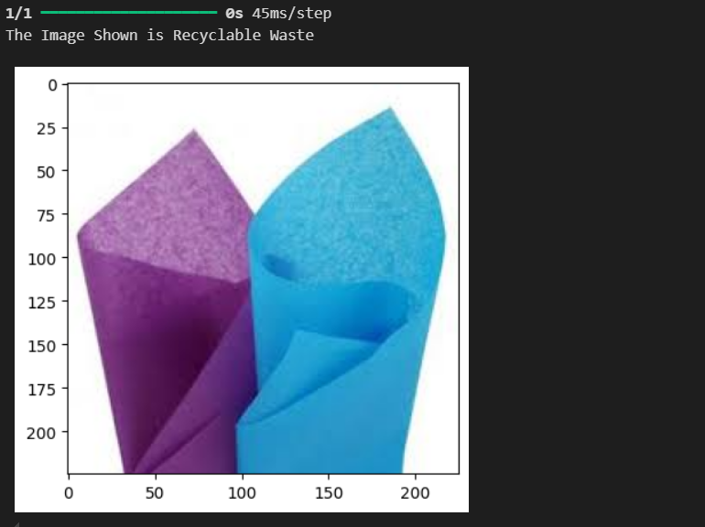

Slide 12
8. Conclusion:
The developed CNN-based waste classification model effectively identifies and categorizes waste into organic and recyclable categories, promoting efficient waste management. By integrating AI and deep learning, this solution enhances sorting accuracy, reduces human effort, and supports sustainable environmental practices. With future advancements, the model can be expanded to classify additional waste types, integrate with smart waste management systems, and contribute to a circular economy.
8.1 Future Enhancements:
Multi-Category Classification: Extend model capabilities to classify hazardous and e-waste.
Integration with IoT Smart Bins: Enable real-time waste sorting and monitoring.
Mobile & Web Deployment: Develop an app for instant waste recognition using camera input.

Slide 13
THANK YOU

